Slide 1

CAPTURE THE FLAG
A Web-Based Multiplayer Educational Game Platform
Module: COMP2003 - Computing Group Project Client: Dr Rory Hopcraft, University of Plymouth Group: Group 6 | 2025–2026

Slide 2

The Problem & Our Client
WHY DOES THIS NEED TO EXIST?
OUR CLIENT
Sitting through lectures on network security is genuinely hard to stay engaged with
There's nothing out there that mixes real cyber-security content with actual game mechanics
The platforms that do exist are built for professionals, expensive and overkill for a classroom
Dr Rory Hopcraft
Lecturer in Cyber Security
University of Plymouth
Tools like Kahoot are great for recall but can't generate subject-specific questions on demand
He came to us with a clear goal, make his classes more engaging. He was collaborative, honest with his feedback, and gave us real creative freedom.
COMP2003 – Capture the Flag | Group 6

Slide 3
What We Built
Students join a live classroom session with a PIN, pick a team, answer quiz questions and play mini-games, all scored in real time.
🔐
📌
🧠
Sign in with Google
Join with a PIN
AI-generated questions
No passwords, no accounts to create.
Just sign in with the Google account you already have.
Teacher creates a session and shares a
6-digit PIN. Students type it in and they're in.
Teacher types a topic. Gemma3 AI generates
8 quiz questions. Teacher reviews and uploads.
🎮
📊
⚡
Four mini-games
Live scoreboard
Role abilities
Stacker, Jumper, Flapper and Snake,
randomly picked each round. Built in Unity WebGL.
Both team scores update in real time
for everyone in the room. No refresh needed.
Each of the four roles has a unique
gameplay advantage, more on this later.
COMP2003 – Capture the Flag | Group 6

Slide 4
How We Worked - Agile Sprints
We ran 5-6 week Agile sprints, reviewed progress with Dr Ji-Jian Chin, and split work by each person's strengths so nobody was blocking anyone else.
The Team
Name | Background | What they owned
Marc Jones | Game design, web games, Unity | Mini-games, AI integration, game loop logic, sprint management
Aarju Shrestha | Frontend, full-stack, databases | Firebase auth + database, frontend HTML/CSS, page routing, PIN system
Edward Hadnett | Cyber security, game development | Mini-games, multiplayer mechanics, system design diagrams
Nicholai Baes | Cyber security, networks | Sound design, accessibility features, QA, limitations, conclusion
🔄 Iterative delivery
💬 Honest reviews
🛠️ Tools used
Each sprint ended with a working demo, not a list of promises.
Sprint meetings with Dr Chin kept us honest about what was done and what wasn't.
GitHub for version control, Trello for backlog, pull requests to keep main branch clean.
COMP2003 – Capture the Flag | Group 6

Slide 5
System Design: Architecture & Flow
No custom server in the game path, everything goes straight from the browser to Firebase. The only server we run is for AI question generation.
Firestore Schema
Student Journey
Collection | Stores
users/{uid} | Profile, email, role (student/teacher)
rooms/{roomId} | PIN code, status, host UID
rooms/.../questions | Question bank uploaded by teacher
matches/{matchId} | Match record, winner, timestamps
matches/.../teams | Team A and B running scores
player_stats/{uid} | Lifetime score and accuracy %
🔐
Sign In
Google OAuth
📌
Enter PIN
Join the room
⚔️
Pick Role
Team A or B
⏳
Lobby
Wait for teacher
🧠
4 Questions
Timer + multiplier
🎮
Mini-Game
Score × multiplier
📊
Submit
Firebase gets the score
COMP2003 – Capture the Flag | Group 6

Slide 6
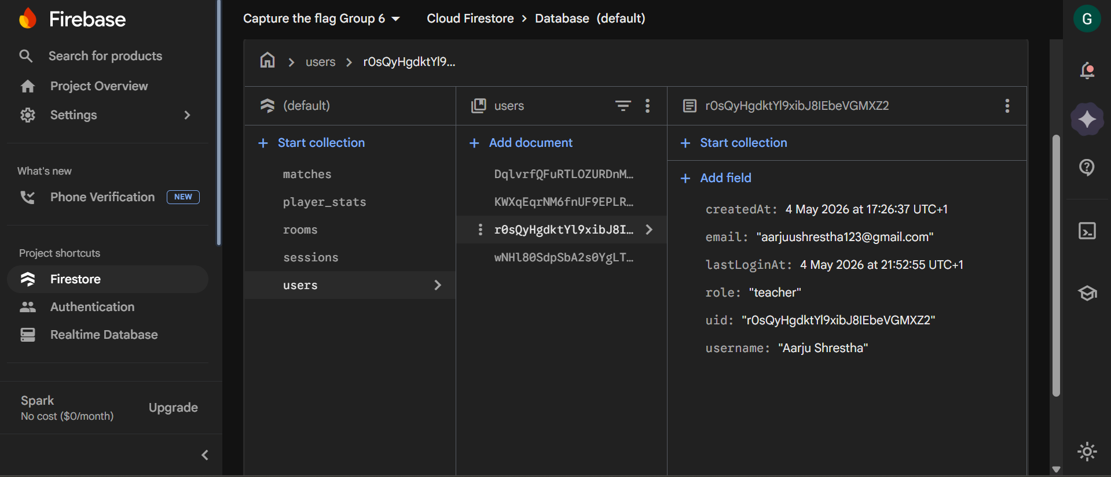
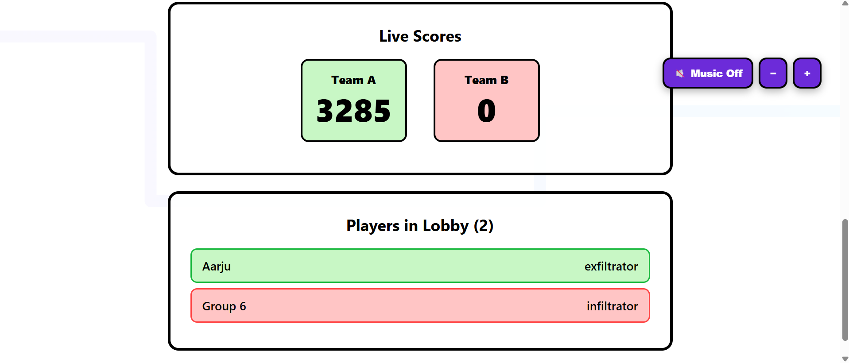
Firebase: Authentication & Real-Time Database
We used Firebase for everything backend. It meant no server to maintain and real-time updates out of the box.
Firebase Console
Google Sign-In
Two separate paths: student and teacher. Role is checked from Firestore, not decided by which button you pressed.
6-Digit PIN
Teacher creates a room, gets a PIN. Student types it in, gets the roomId. Simple as that.
Live Scores
Live Game in Action
onSnapshot listeners update both team scores in real time for every player: no refresh, no polling.
Safe Writes
increment() prevents race conditions when two students submit scores at the exact same moment.
COMP2003 – Capture the Flag | Group 6

Slide 7
AI Question Generation
Teachers type a topic, the AI does the work. They review it, fix anything wrong, and upload. Done.
Teacher
types topic
→
Node.js
sends to Ollama
→
Gemma3-4b
generates JSON
→
Cleanup
pipeline
→
Teacher
reviews + uploads
Why Gemma3-4b?
The prompt
We tried the 1b model, too inconsistent. Anything bigger than 4b was overkill for generating MCQs. 4b hit the sweet spot.
We tell it: JSON only, 8 questions, keys 0–7, four answers each, no extra text. It took a few iterations to get this right.
Why a cleanup step?
The editor
The model sometimes wraps the JSON in extra text despite instructions. We strip that out with .replace() and brace extraction.
Rather than making teachers edit JSON manually, we built a form editor: click, type, save. No coding needed.
COMP2003 – Capture the Flag | Group 6

Slide 8
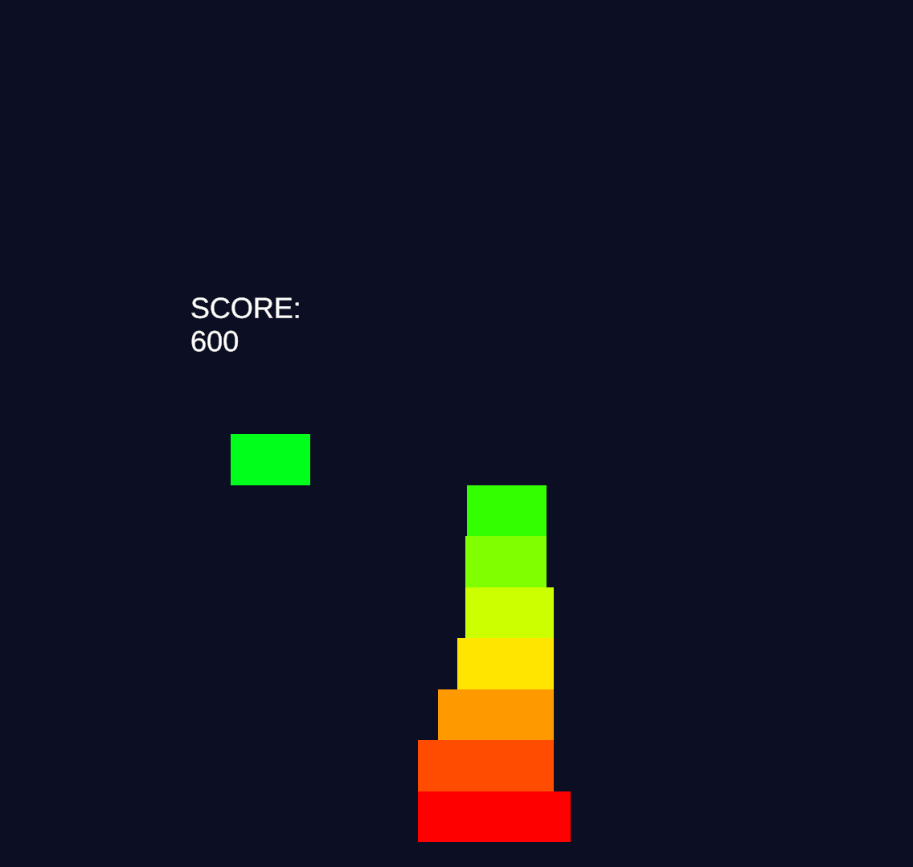
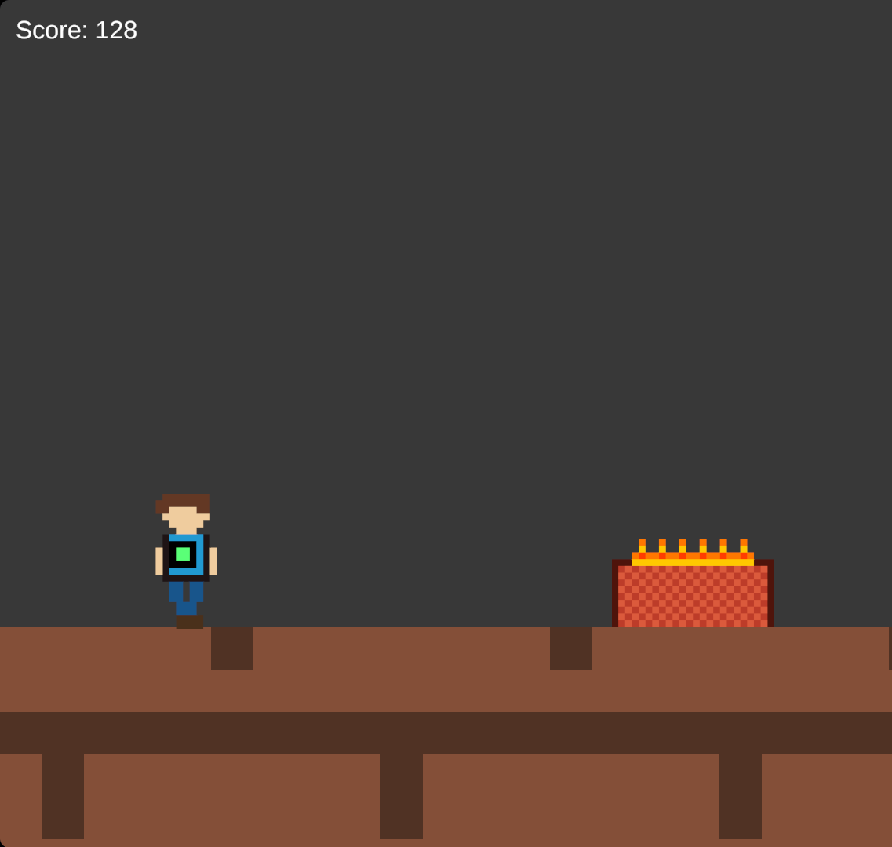
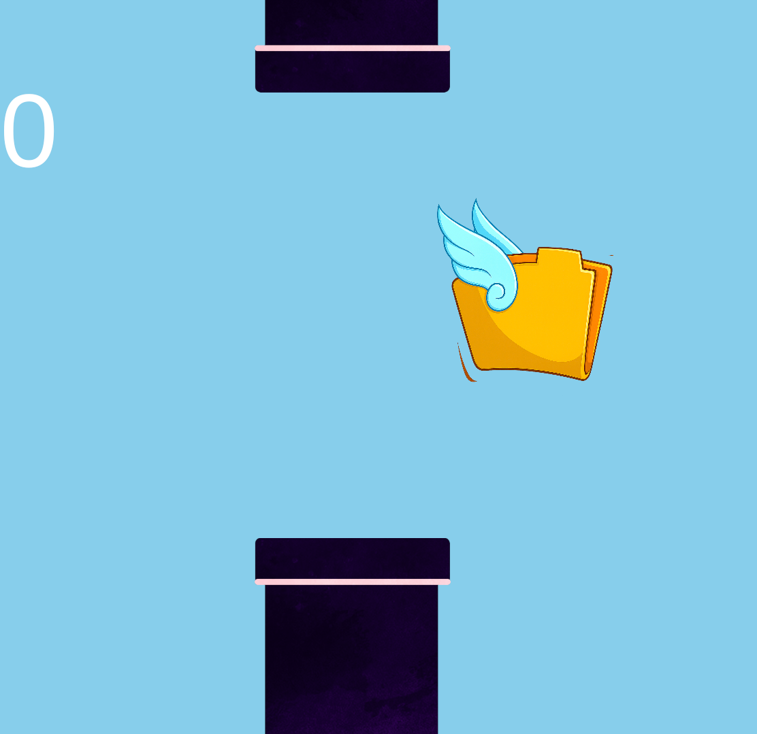
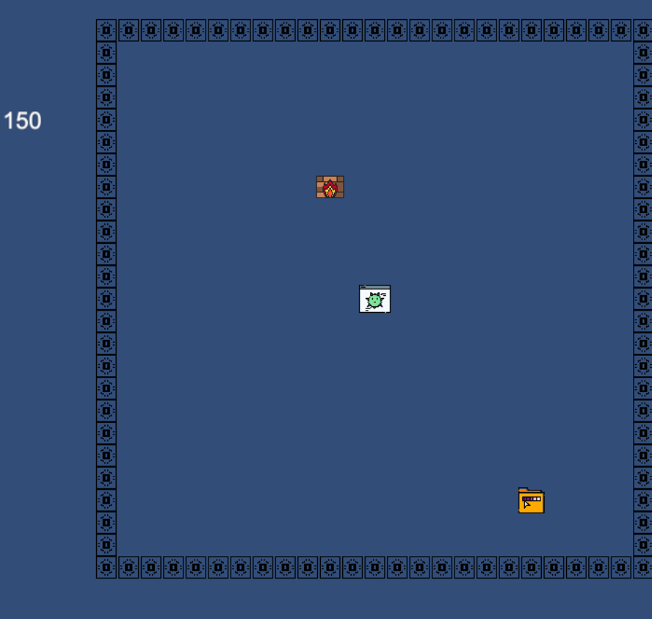
Game Development
The Loop
Join
Lobby
›
Answer
4 Questions
›
Build
Multiplier
›
Briefing
Screen
›
Play
Game
›
Score
Submitted
›
Loop or
Finish
The Mini-Games - built in Unity, exported as WebGL, embedded in an iframe
Stacker
Drop blocks to build
the tallest tower. SPACE to drop.
Jumper
Jump over obstacles
moving left. Speed increases.
Flapper
Fly through a random gap in each obstacle.
Snake
Eat collectables to grow. Avoid your own tail.
COMP2003 – Capture the Flag | Group 6

Slide 9
Frontend Design & Accessibility
No frameworks: just HTML, CSS and vanilla JavaScript. Nine pages, each with one job.
Design
Accessibility
🎨
Retro hacker aesthetic, dark background, purple primary (#6c2bd9), cyan highlights (#00e5ff)
A settings widget appears on every page with three options, all saved to localStorage so they stick when you navigate.
🌙
Dark Mode
📱
Responsive at 1000px and 700px, mascot hides on mobile, cards stack on narrow screens
data-theme="dark" swaps
the whole colour palette
⏱️
Quiz timer bar shrinks over 10 seconds with a CSS transition, turns red at 3 seconds left
🔤
Text Scaling
A– and A+ resize everything
via a --font-scale CSS variable
🔊
Click and confirm sounds via Web Audio API when selecting roles and joining
⬛
High Contrast
🌐
Session state lives in localStorage, passes between pages without a server
Replaces translucent cards
with solid black and white
COMP2003 – Capture the Flag | Group 6

Slide 10
Role-Based Gameplay: Four Roles, Four Abilities
Roles aren't just labels. Each one changes something about how you play, and teams with a mix of roles will perform differently.
🕵️
Infiltrator
⚔️
Exploit
15 seconds per question
(everyone else gets 10)
+0.5x multiplier per correct
(standard is +0.25x)
Ghost mode. More time to think. Perfect if the topic is unfamiliar.
Double the multiplier gain. Answer everything right and you'll be at 3x after four questions.
quizTimeLimit = 15
multiplier += 0.5
🏃
Exfiltrator
🛡️
Firewall
+8s bonus game time per correct
(standard is +5s)
Wrong answers don't break
your multiplier streak
More correct answers means more time in the mini-game. Every second counts.
Everyone else loses their streak on a wrong answer. Firewall keeps it going regardless.
quizBonusTime += 8
if (firewall) multiplier += 0.25
COMP2003 – Capture the Flag | Group 6

Slide 11
Quality Assurance
We treated testing as a continuous thing, not a box to tick at the end.
19
4
15/15
3
Test cases run
Bugs caught
& fixed
AI JSON
outputs valid
Browsers
checked
Bugs we found and fixed
What real users told us
🔴→🟢 Whitespace in correctAns from AI was silently failing answer checks, fixed with .trim()
Dr Hopcraft reviewed the system three times during development. Students tested the join flow without any guidance from us.
🔴→🟢 Firestore WebSocket blocked on localhost, switched to HTTP long polling
✅ 'Session PIN' label confused people → reworded to 'Enter the PIN your teacher gave you'
🔴→🟢 Timer bar animating on reset, fixed with forced reflow using offsetWidth
✅ Students forgot their team while waiting → added team display to waiting page
✅ AI setup was bundled with game setup → separated into its own tool
🔴→🟢 Misplaced import in teacher.html was crashing the entire module script
✅ PIN on game page was mistaken for a score → relabelled 'Room PIN'
COMP2003 – Capture the Flag | Group 6

Slide 12
Limitations & What's Next
The system works and meets the brief. But we're honest about what it can't do yet, and we know exactly what we'd fix first.
Current limitations
If we kept going...
The AI server runs on the teacher's machine. If they haven't set up Ollama, the question generator doesn't work.
Host the AI server online so teachers don't need to set anything up locally
More mini-games, the architecture already supports adding them
Four mini-games is fine for one session. Come back a second week and students will have seen them all before.
A teacher analytics view: per-question accuracy, who contributed what, team breakdowns
Session state is in localStorage. A student clearing their browser mid-session will lose their place.
A leaderboard, the data is already in Firestore, it just needs a front end
We have no automated tests for Firebase security rules or role-based access, those were all manual.
A security section: proper Firestore rules, role enforcement and AI output validation
COMP2003 – Capture the Flag | Group 6

Slide 13
Conclusion
What we actually built
A working, classroom-ready multiplayer learning platform. Teachers generate questions with AI, students join with a PIN, answer quizzes, play mini-games, and compete in real time, all with zero server maintenance required. It does exactly what Dr Hopcraft asked for.
✅ End-to-end game loop with real-time Firebase sync
✅ Google OAuth with proper teacher/student role separation
✅ AI question pipeline with human review step
✅ Four Unity WebGL mini-games, randomly selected each round
✅ Role-based gameplay mechanics for all four roles
✅ Full teacher dashboard — create, upload, launch, monitor, end
What we learned
Full-stack dev · Real-time databases · AI integration · Unity WebGL · Agile sprints · Client communication
Thank you · Any questions? · Marc Jones · Aarju Shrestha · Edward · Nicholai Baes
COMP2003 – Capture the Flag | Group 6

